Slide 2
Portfolio Strategy
Microsoft Project 2010 Ignite

Slide 3
Agenda
Introduction
Business Drivers
Overview
Explanation
Demonstration
Portfolio Analyses
Overview
Explanation
Demonstration

Slide 4
Introduction

Slide 5
Why is Effective Portfolio Management Important?
Portfolio Management
Enables organizations to identify and select the investments that will maximize business value
50% Value Lost
Portfolio
Management
Ability to identify business value potential
Project Management
Helps ensure organizations successfully deliver the selected investments and realize the business value
66%
50% Value Realized
Project
Management
75%
Ability to realize business value potential

Slide 6
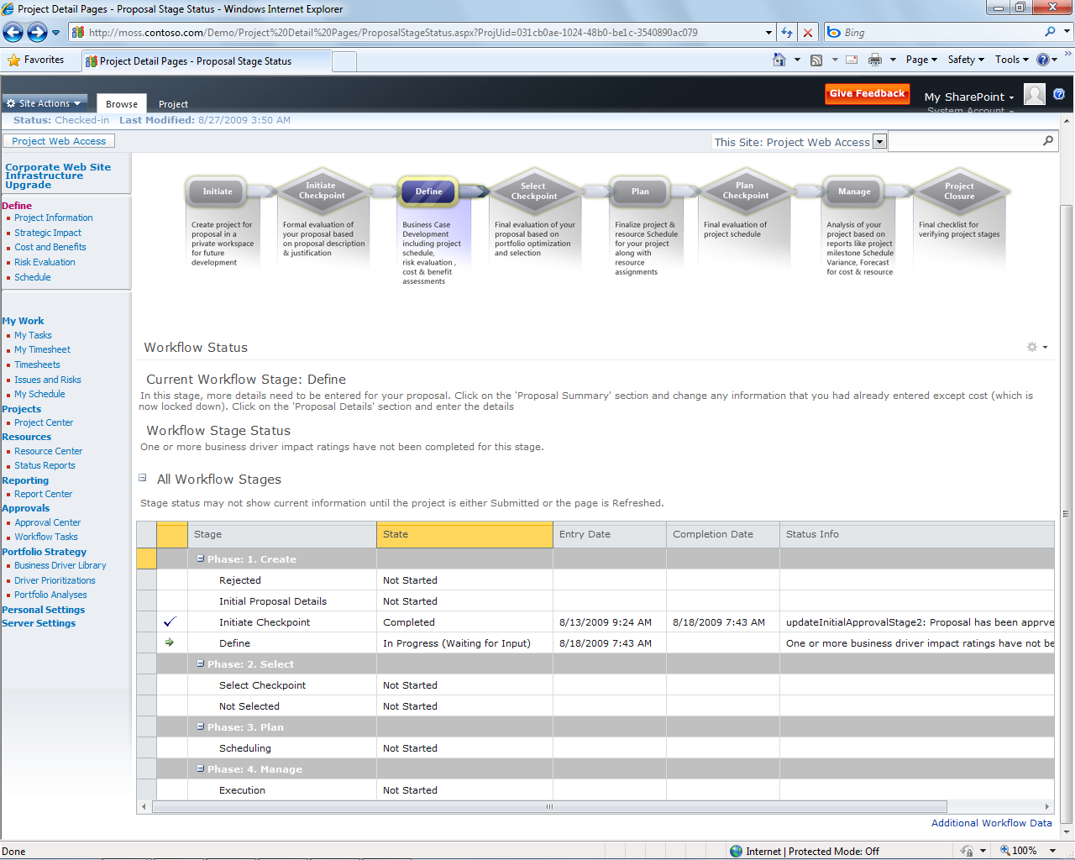
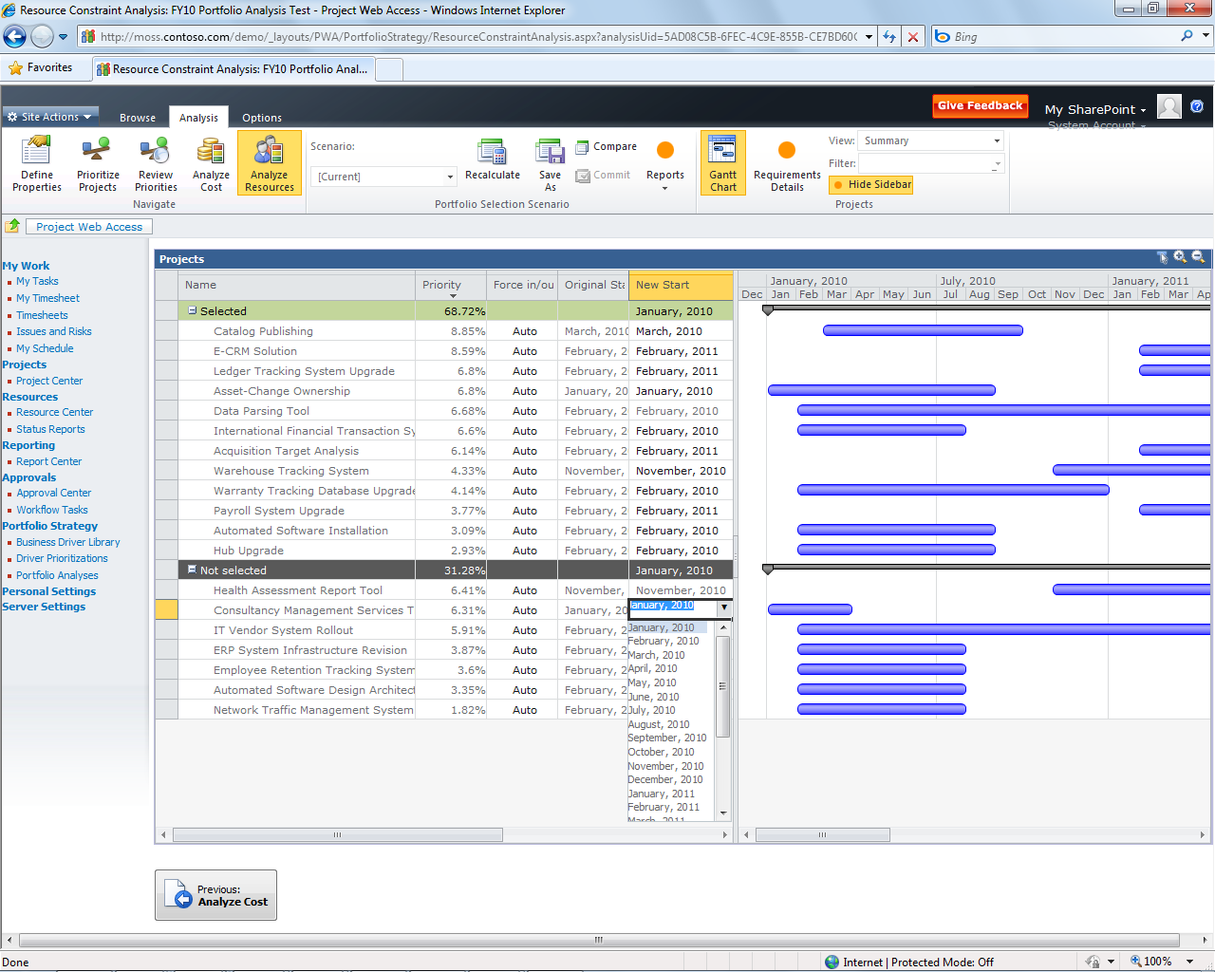
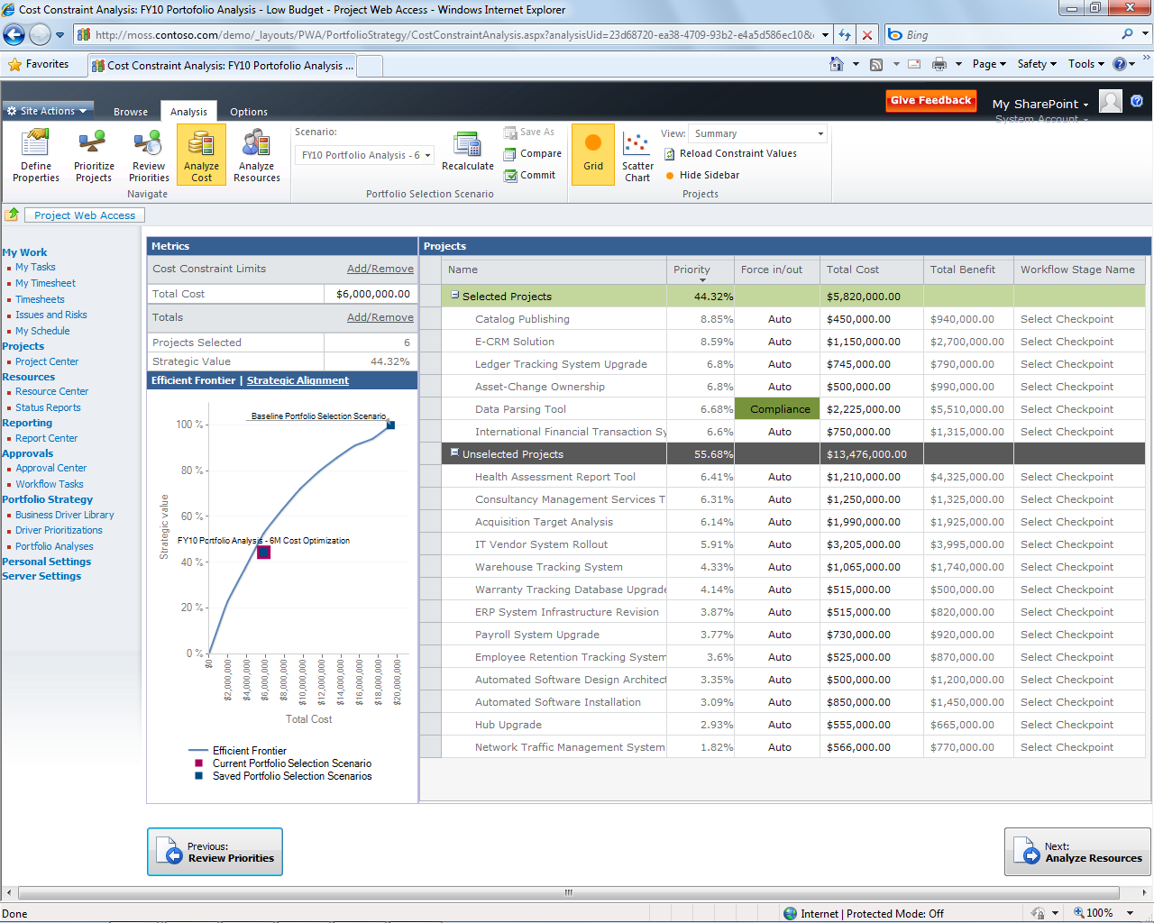

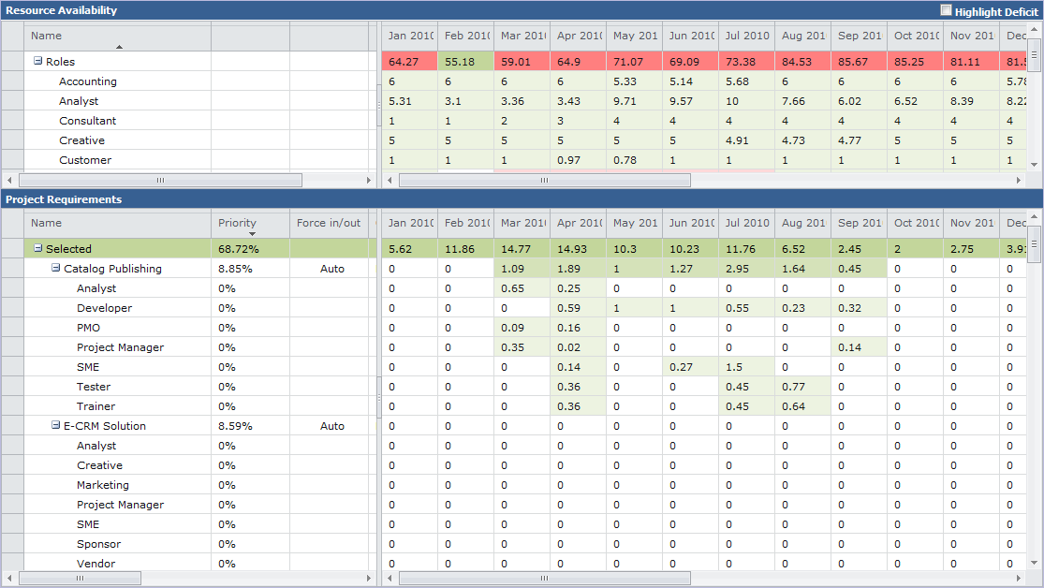


Unified Project and Portfolio Management Key benefits of Project Server 2010
Common streamlined user interface
Shared platform/architecture
Leverages scalable queue architecture
All data available via read/write Project Server Interface (PSI)
Final selection decisions published to Reporting Database (RDB)
No gateway required
New Resource Analysis
Unified Project and Portfolio Management
Enhanced Collaboration and Reporting
Scalable and Connected Platform
Simple and Intuitive User Experience

Slide 7
Process Overview
Business Drivers Definition
Business Drivers Prioritization
Aligning Projects/Proposals to Business Drivers
Projects/Proposals Prioritization
Portfolio Analysis (cost, resource)

Slide 8
Related Resources
WebCasts - http://www.microsoft.com/events/series/epm.aspx
TechNet Webcast: Microsoft Project 2010 Portfolio Analysis (Level 200) by Hilde Corbu, Project MVP
Videos and sessions http://www.microsoft.com/showcase/en/US/channels/microsoftproject/
Project Server 2010 - Portfolio Management by Luke Humphrey and Catalin Olteanu

Slide 9
Business Drivers

Slide 10
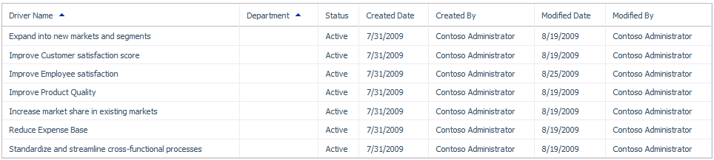
Business Driver
Business Drivers represent an organization’s business objectives in Project Server 2010
Create drivers in the Business Driver Library
May be associated with zero or more Departments
Drivers are prioritized to reflect organization’s perceived business impact and importance
Notes:
Business Drivers not associated with any Department is considered a global driver. When rating a project’s impact on a set of drivers, only drivers that share the same department of the project and all global drivers will be available and/or required for impact ratings. If the project does not have a departmental association, only global drivers will be available for rating.
When a business driver is no longer part of the currently organizational strategy, the driver should either be deleted or inactivated. Choose to inactivate a driver if you no longer want projects to be rated against this driver, but you would like to keep it for historical purposes.

Slide 11
Driver Prioritizations
Two ways to prioritize business drivers:
Calculated: Each driver will be compared to every other driver within the prioritization using a fixed seven-point scale. Once every driver has been rated the system will automatically generate relative priority scores
Manual: Manual prioritizations allow users to specify priority values for each driver directly
Notes:
When creating new driver prioritizations, the prioritization’s department selection will filter the list of available drivers to be prioritized by department. Global drivers will be available regardless of the prioritization’s department. If a department is assigned to a prioritization, only drivers that share that departmental association can be included in the prioritization.

Slide 12
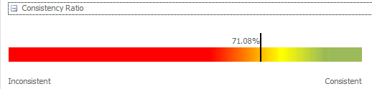
Calculated Driver Prioritization
System calculates the consistency ratio
Inconsistent prioritizations may make sense in some instances but should be reviewed carefully

Slide 13
Calculated Driver Prioritization Algorithm
Fill the systemic matrix with the pairwise values
Calculate eigenvector for the matrix
Normalize eigenvector values to 100% to derive relative priorities
 | Driver A | Driver B | Driver C | Driver D
Driver A | 1 | 9 | 6 | 1
Driver B | 1/9 | 1 | 3 | 1/6
Driver C | 1/6 | 1/3 | 1 | 1/3
Driver D | 1 | 6 | 3 | 1
 | Driver A | Driver B | Driver C | Driver D
Driver A |  | 9 | 6 | 1
Driver B |  |  | 3 | 1/6
Driver C |  |  |  | 1/3
Driver D
 | Driver A | Driver B | Driver C | Driver D
Driver A |  | Extremely More | Strongly More | Equal
Driver B |  |  | Moderately More | Strongly Less
Driver C |  |  |  | Moderately Less
Driver D
 | Driver A | Driver B | Driver C | Driver D
Driver A | 1 | 9 | 6 | 1
Driver B |  | 1 | 3 | 1/6
Driver C |  |  | 1 | 1/3
Driver D |  |  |  | 1

Slide 14
Calculated Driver Prioritization Algorithm
Fill the systemic matrix with the pairwise values
Calculate eigenvector for the matrix
Normalize eigenvector values to 100% to derive relative priorities
 | Driver A | Driver B | Driver C | Driver D
Driver A | 1 | 9 | 6 | 1
Driver B | 1/9 | 1 | 3 | 1/6
Driver C | 1/6 | 1/3 | 1 | 1/3
Driver D | 1 | 6 | 3 | 1
 | Driver A | Driver B | Driver C | Driver D
Driver A |  | 9 | 6 | 1
Driver B |  |  | 3 | 1/6
Driver C |  |  |  | 1/3
Driver D
 | Driver A | Driver B | Driver C | Driver D
Driver A | 1 | 9 | 6 | 1
Driver B |  | 1 | 3 | 1/6
Driver C |  |  | 1 | 1/3
Driver D |  |  |  | 1

Slide 15
Calculated Driver Prioritization Algorithm
Fill the systemic matrix with the pairwise values
Calculate eigenvector for the matrix
Normalize eigenvector values to 100% to derive relative priorities
 | Driver A | Driver B | Driver C | Driver D
Driver A | 1 | 9 | 6 | 1
Driver B | 1/9 | 1 | 3 | 1/6
Driver C | 1/6 | 1/3 | 1 | 1/3
Driver D | 1 | 6 | 3 | 1

Slide 16
DEMO
Business Drivers

Slide 17
Portfolio Analyses
Microsoft Project 2010 Ignite

Slide 18




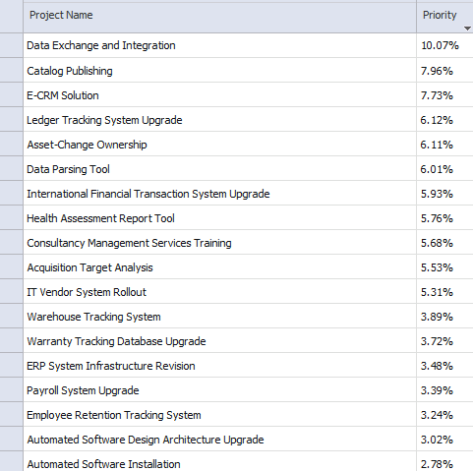
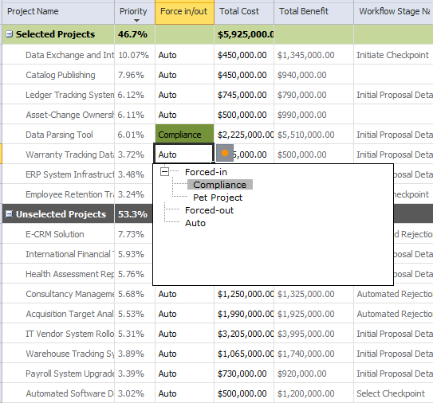
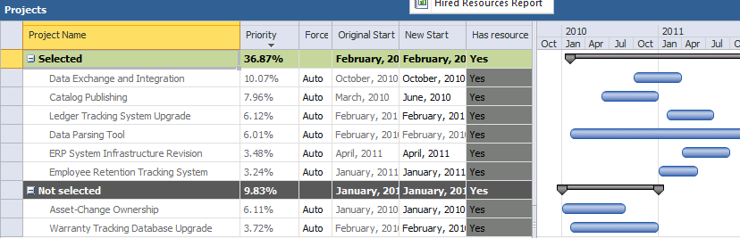
Portfolio Analyses
Portfolio analyses are a collection of projects that will compete for selection based on their cost relative to their strategic value
Prioritization of Projects:
By Business Drivers
By Custom Field

Slide 19
Unified Project and Portfolio Management Further considerations
Three data points feed into the portfolio analysis process:
Cost (Number Custom Field) – e.g. Proposal Cost
Proposal/project impact on business drivers
Departments are supported to “filter” related Business Drivers
Time-phased resource requirements
Proposal will need a Resource Plan or Project Plan

Slide 20
Project Prioritization
Could use:
Business drivers impact statements
Project custom fields with values and relative priorities (manually calculated by user)
More information Project Server 2010 - Portfolio Management by Luke Humphrey and Catalin Olteanu

Slide 21
Project Prioritization Using business drivers impact statements
Fill the impact matrix with the numeric values
Multiply matrix with driver priorities
Normalize resulting absolute values to 100% to derive relative priorities
 | Driver A | Driver B | Driver C | Driver D
Project 1 | 0 | 3 | 1 | 9
Project 2 | 9 | 1 | 1 | 0
Project 3 | 1 | 3 | 0 | 3
Project 4 | 0 | 1 | 0 | 1
Project 5 | 1 | 6 | 0 | 0
 | Driver A | Driver B | Driver C | Driver D
Project 1 | None | Moderate | Low | Extreme
Project 2 | Extreme | Low | Low | None
Project 3 | Low | Moderate | None | Moderate
Project 4 | None | Low | None | Low
Project 5 | Low | Strong | None | None

Slide 22
Project Prioritization Using business drivers impact statements
Fill the impact matrix with the numeric values
Multiply matrix with driver priorities
Normalize resulting absolute values to 100% to derive relative priorities
 | Driver A | Driver B | Driver C | Driver D
Project 1 | 0 | 3 | 1 | 9
Project 2 | 9 | 1 | 1 | 0
Project 3 | 1 | 3 | 0 | 3
Project 4 | 0 | 1 | 0 | 1
Project 5 | 1 | 6 | 0 | 0
Driver priorities
A: 41%
B: 25%
C: 22%
D: 12%
X

Slide 23
Project Prioritization Using business drivers impact statements
Fill the impact matrix with the numeric values
Multiply matrix with driver priorities
Normalize resulting absolute values to 100% to derive relative priorities
 | Driver A | Driver B | Driver C | Driver D
Project 1 | 0 | 3 | 1 | 9
Project 2 | 9 | 1 | 1 | 0
Project 3 | 1 | 3 | 0 | 3
Project 4 | 0 | 1 | 0 | 1
Project 5 | 1 | 6 | 0 | 0
Driver priorities
A: 41%
B: 25%
C: 22%
D: 12%
Project priorities
P1: 20%
P2: 42%
P3: 15%
P4: 4%
P5: 19%
X
=

Slide 24
Project Interdependencies
Project dependency relationship will be respected during portfolio selection scenario calculations
There are following types of interdependencies:
Dependency: If Project A selected, Project B must be selected
Mutual Inclusion: For a set of projects, if one project is selected, all projects in the set must be selected.
Mutual Exclusion: For a set of projects, only one project in the set can be selected (Alternatives).
Finish to Start: Used in Resource Constraint Analysis for identifying scheduling constrains

Slide 25
Cost constraint analysis

Slide 26
Constraint Optimization The need for optimization
Available budget: $100
Request: chose the projects that provide maximum value to the business
Top-down selection
Optimization
 | Value | Cost
Project 1 | 30% | $100
Project 2 | 20% | $60
Project 3 | 15% | $40
 | Value | Cost
Project 1 | 30% | $100
Project 2 | 20% | $60
Project 3 | 15% | $40
Total strategic value: 30%
Total strategic value: 35%

Slide 27
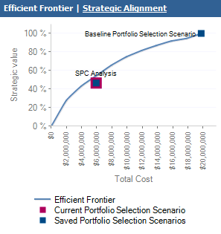
Constraint Optimization Algorithm
Maximize (x1*v1+x2*v2+x3*v3+ … +xn*vn)
Subject To:
x1*c1+x2*c2+x3*c3+ … +xn*cn <= C
Where
x1, x2… xn = 0 or 1 (algorithm outputs: project in/out)
v1, v2… vn are the project priorities
c1, c2… cn are the constraint values for each project
C is the total constraint value; we have one such row for each constraint
Efficient frontier (based on one constraint):
For N data points equally spaced between zero and the sum of the constraint
Run Optimization algorithm and determine corresponding portfolio value

Slide 28
Force In/Out
A portfolio may contain projects that must be either selected or not selected, regardless of their cost/value ratio or their dependencies on other projects.
Aliases available for “Force In/Out” per analysis
Examples:
A non-strategic project that must be implemented because of legal compliance issues will need to be “forced in” the portfolio.
A very costly project might need to be “forced out” of a portfolio to free up resources for other projects and improve the portfolio’s overall ROI
Notes:
ROI = Return on Investment

Slide 29
DEMO
Cost Analysis

Slide 30
Resource constraint analysis

Slide 31
Resource Constraint Analysis Related Portfolio Analysis Configuration
Specify the resource custom field that defines role
Specify the planning horizon dates and granularity
Filter resources by department or RBS value
Consider proposed bookings when calculating capacity for projects outside the analysis (advanced)
Specify how project dates are set
Respect the project resource plan setting which allows pulling resource requirement data from the project schedule, the resource plan, or a mixture of the two
Use project date custom fields to specify dates

Slide 32
Resource Constraint Analysis Simplified Algorithm – Resource Allocation
Portfolios may also be analyzed by their high-level resource requirements combined with their prioritization
Higher priority projects are resourced first, lower priority projects are resourced last.
If resource availability does not meet a given project’s demand for any period for any role, that project is not resourced and the project with the next lowest priority is examined

Slide 33
DEMO
Resources Analysis

Slide 34
And when you’re done?

Slide 35
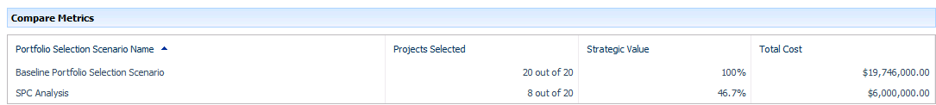
Portfolio Comparison
Portfolio selections scenarios should be adjusted and recalculated until a scenario is reached that should be finalized or compared with other scenarios
Portfolios may be compared with each other by:
Projects Selected
Strategic Value
Custom Fields (example: ROI )

Slide 36

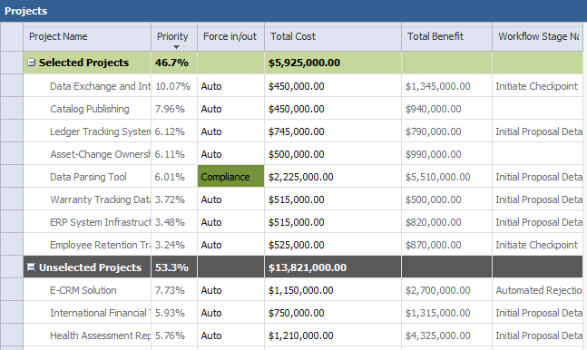
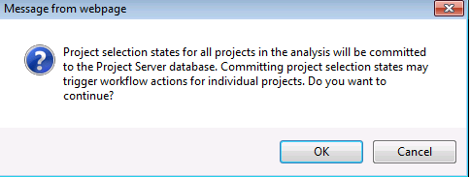
Commit Portfolio Analysis Decisions
Once you have completed your portfolio analysis, the final step is to commit your portfolio
Optionally, committed portfolios may kick off a workflow

Slide 37
DEMO
Comparing Portfolio Selection Scenarios

Slide 38
Summary
Business Drivers
Overview
Explanation
Demonstration
Portfolio Analyses
Overview
Explanation
Demonstration

Slide 39

- Resources
Product information and trial download
http://www.microsoft.com/project
Project Team Blog http://blogs.msdn.com/project
Interactive content - Videos & Sessions & Webcasts
http://www.microsoft.com/showcase/en/US/channels/microsoftproject
http://www.microsoft.com/events/series/epm.aspx
IT Professional related
TechCenter @ TechNet http://technet.microsoft.com/ProjectServer
Admin Blog http://blogs.technet.com/projectadministration
Developer related
Developer center @ MSDN http://msdn.microsoft.com/Project
Programmability blog http://blogs.msdn.com/project_programmability
Additional questions? Project 2010 Forums!
http://social.msdn.microsoft.com/Forums/en-US/category/projectserver2010,projectprofessional2010
SharePoint 2010
http://sharepoint.microsoft.com
FORUMS
Project Professional 2010
General Questions and Answers
Project Server 2010
General Questions and Answers
Setup, Upgrade, Administration and Operation
Customization and Programming

Slide 40

© 2009 Microsoft Corporation. All rights reserved. Microsoft, Windows, Windows Vista and other product names are or may be registered trademarks and/or trademarks in the U.S. and/or other countries.
The information herein is for informational purposes only and represents the current view of Microsoft Corporation as of the date of this presentation. Because Microsoft must respond to changing market conditions, it should not be interpreted to be a commitment on the part of Microsoft, and Microsoft cannot guarantee the accuracy of any information provided after the date of this presentation. MICROSOFT MAKES NO WARRANTIES, EXPRESS, IMPLIED OR STATUTORY, AS TO THE INFORMATION IN THIS PRESENTATION.

